Slide 1
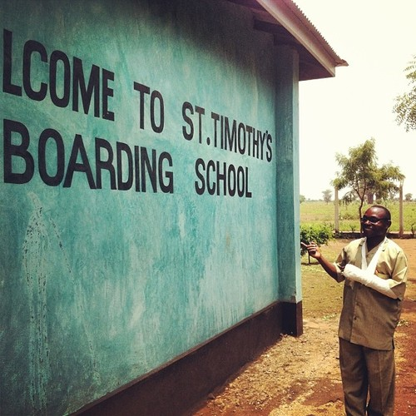
Physics PBL
The question:
How can we improve the living / school conditions of students by providing access to electricity through renewable energy sources?

Slide 2
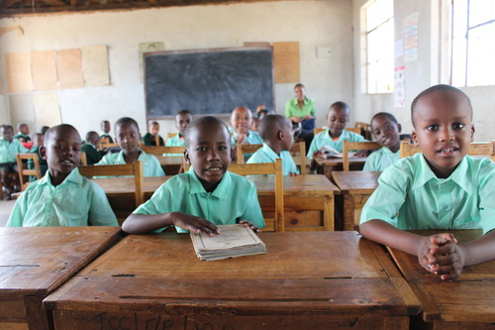
A bit more about the school:
St. Timothy’s was set up and is ran by a husband and wife team, James and Beatrice Nathaniel.
The school started when this couple brought in vulnerable (mostly orphaned) children into their own home and gave them an education.
St. Timothy’s serves the community of Newland (just outside of Moshi Tanzania)
The school placed 2nd our of 52 schools in the Moshi national exams in 2013! They place 7th in 2014.

Slide 3
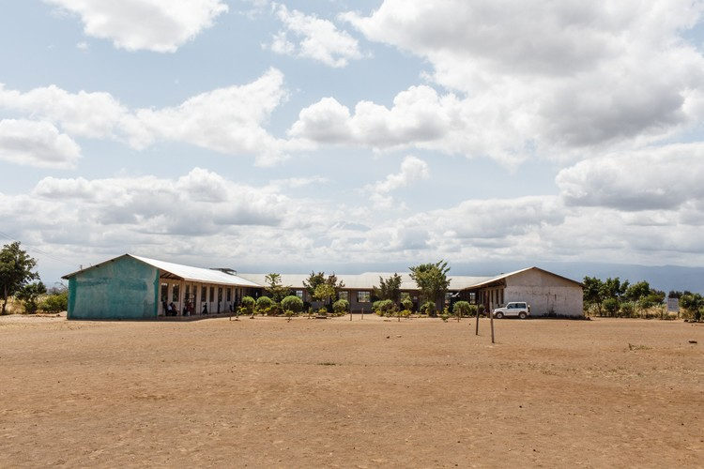
Watch the video (link below) about the school grounds. Watch carefully! Think about what you see and what you could help improve.
https://www.youtube.com/watch?v=FUx1aznJXhw

Slide 4
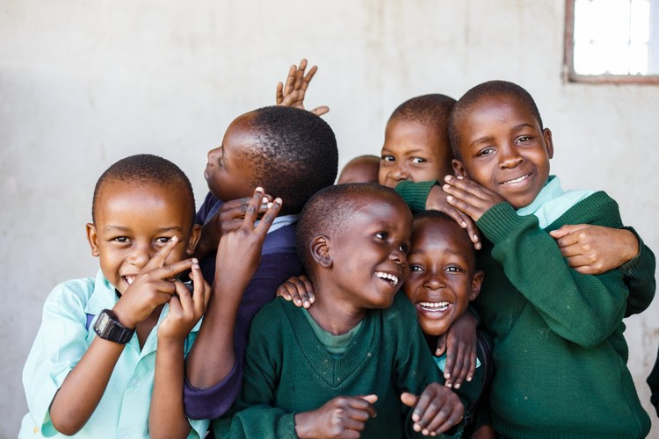
A bit more about the students
Out of the 300 students who attend, one third of the students are vulnerable – many are orphans
For every 2 students that pay to attend school,
1 child goes for free
Many students come to school for the day and then go home. Students that don’t have a home stay in the hostel (boarding house).

Slide 5
The PBL website
We are sharing access to electricity with this school in Tanzania!
Write this down and check it out!
sharethespark.weebly.com
While researching, use this site to find the roles, rubrics you will be graded on, useful websites, task lists of what you need to get done, and a calendar.

Slide 6
For today
In your PBL groups Start thinking about:
what energy source do you want to use. (wind, solar, geothermal, biomass, hydro, human movement, …)
What are you trying to do?
I.E. (provide light, heat food, recharge laptops…..)
There are many things you can provide electricity for but I would begin focusing on one “thing” for your PBL
Complete the “Physics PBL Initial Plan” and email to me BEFORE THE END OF THE PERIOD!

Slide 7
OVER BREAK
Now that you have roles for each person in your group:
Complete your “PBL Initial Individual Research” worksheet. Due Monday 11/30/15
The ball is in your court. You have a responsibility to complete YOUR JOB for your group.
This is your first chance to show your group you will do your part!
You only need bits of time over a couple days to do a good job.
Email me or your group members for help
Share phone numbers/emails between your group

